Slide 1



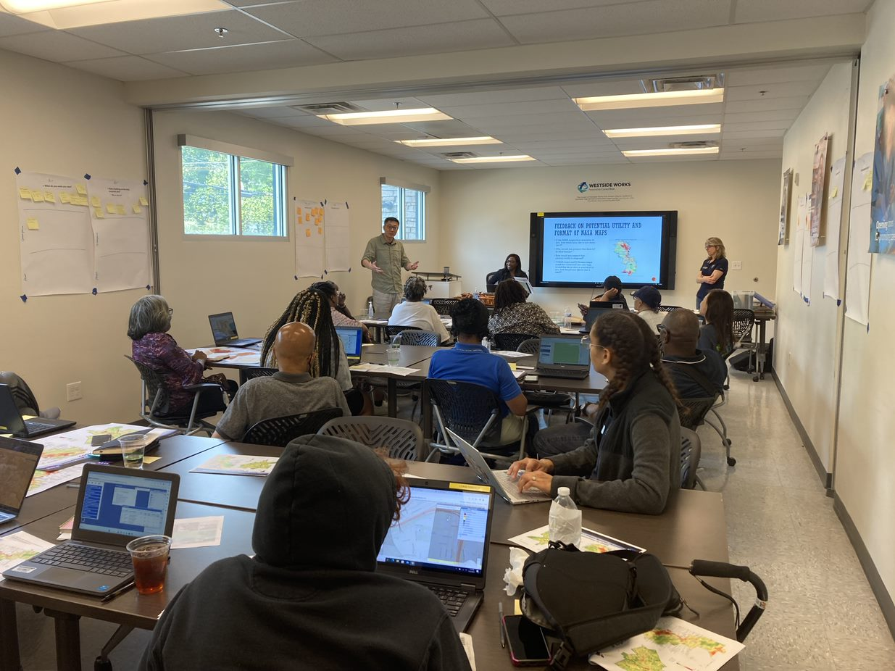
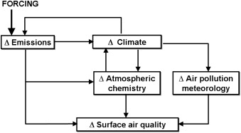
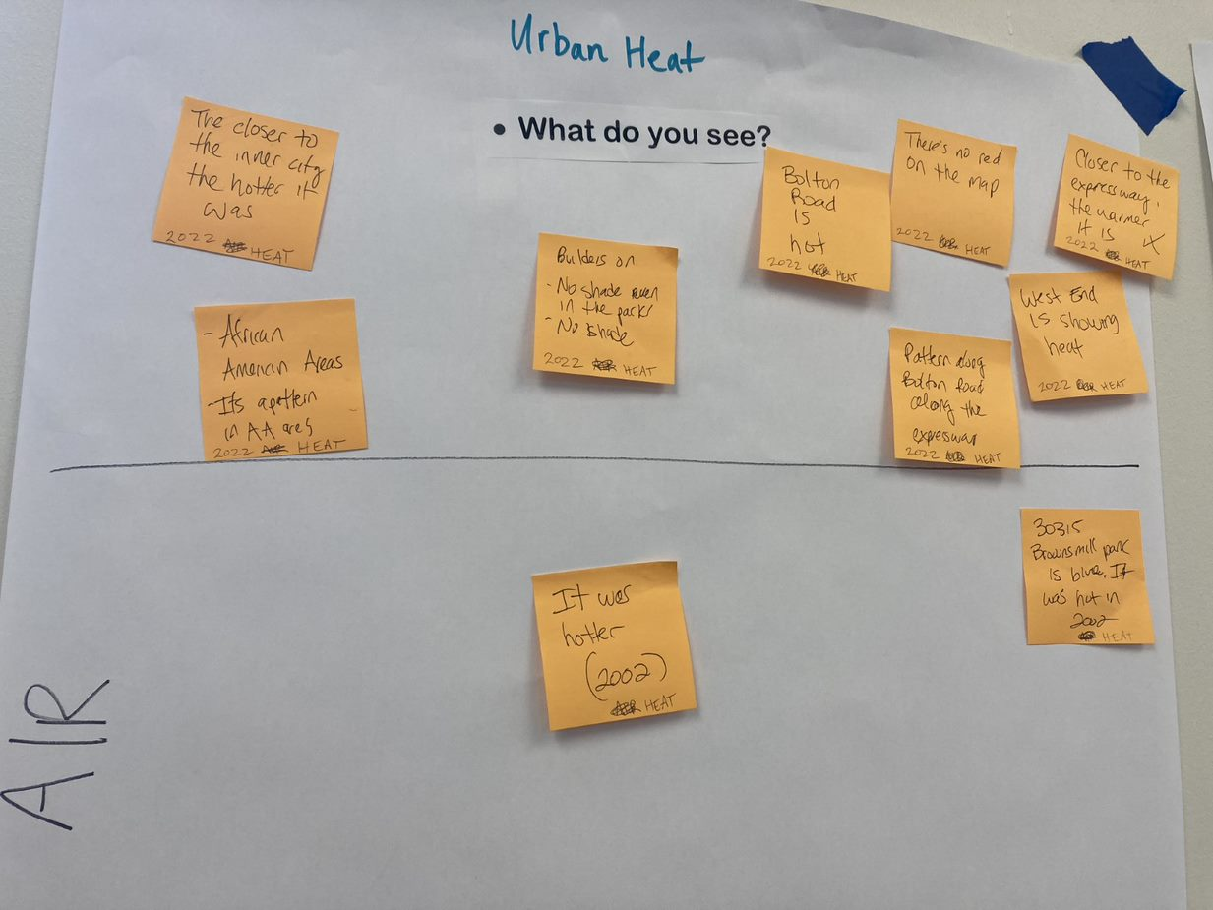
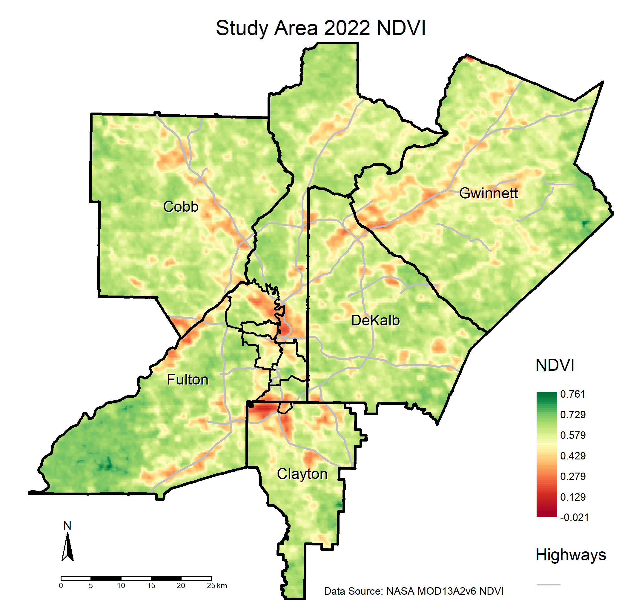
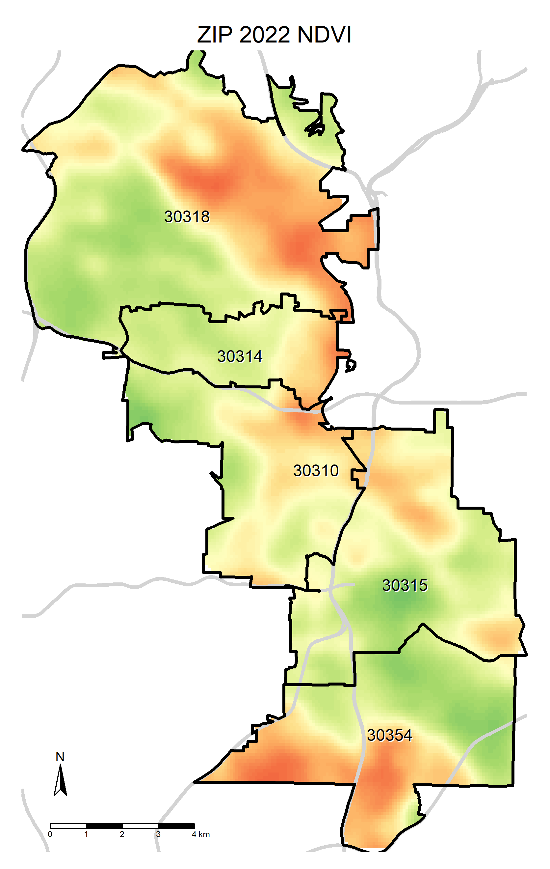
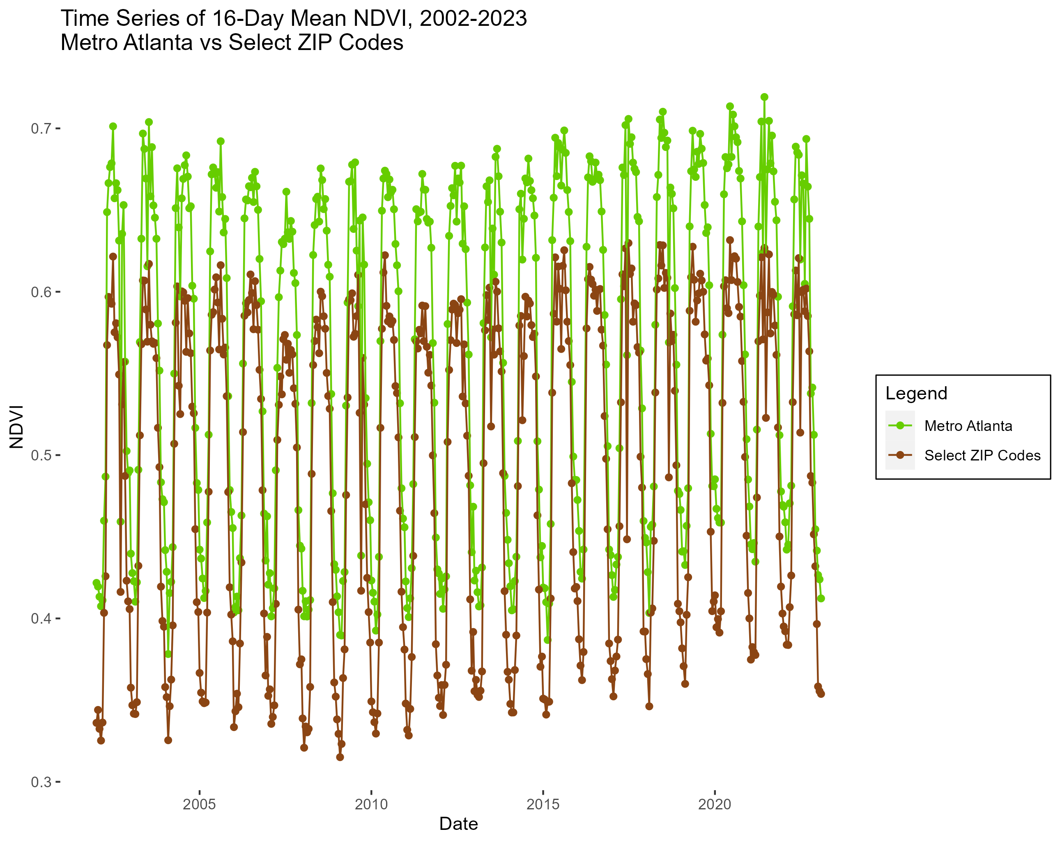
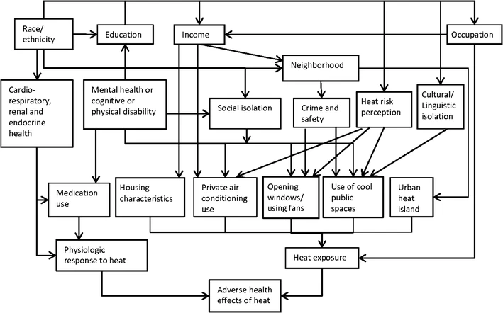
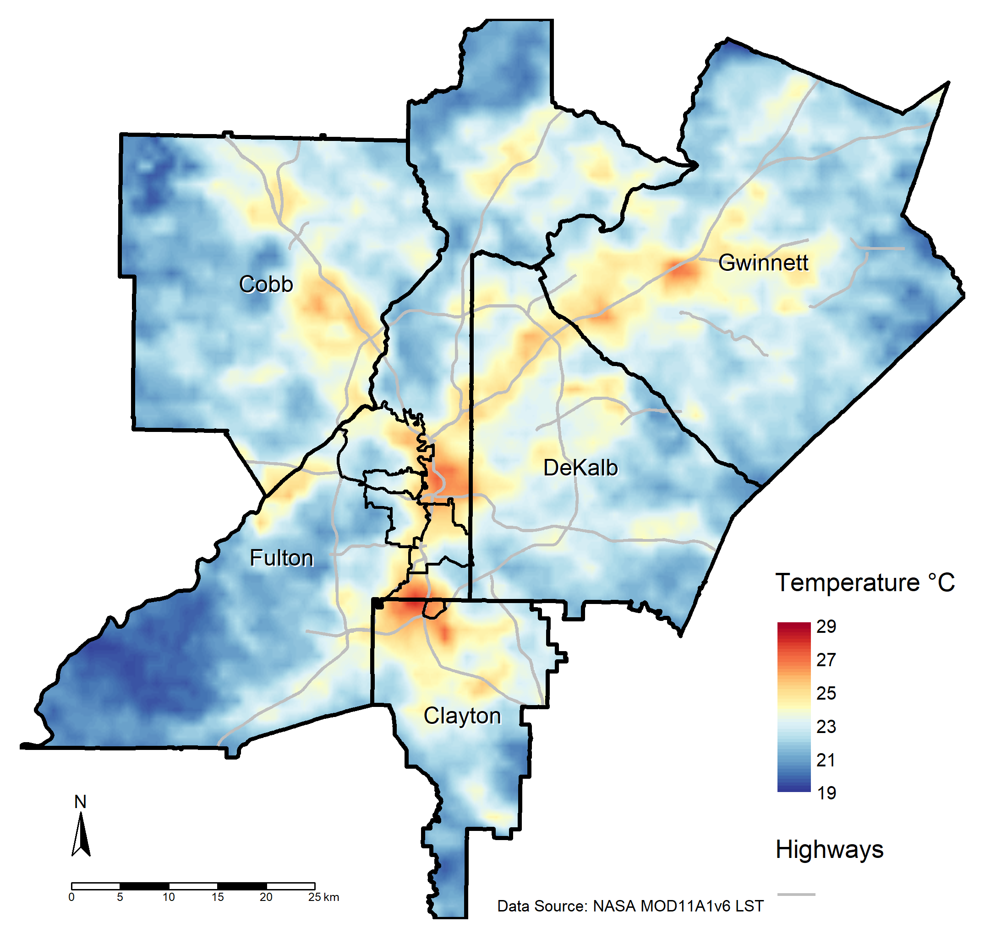
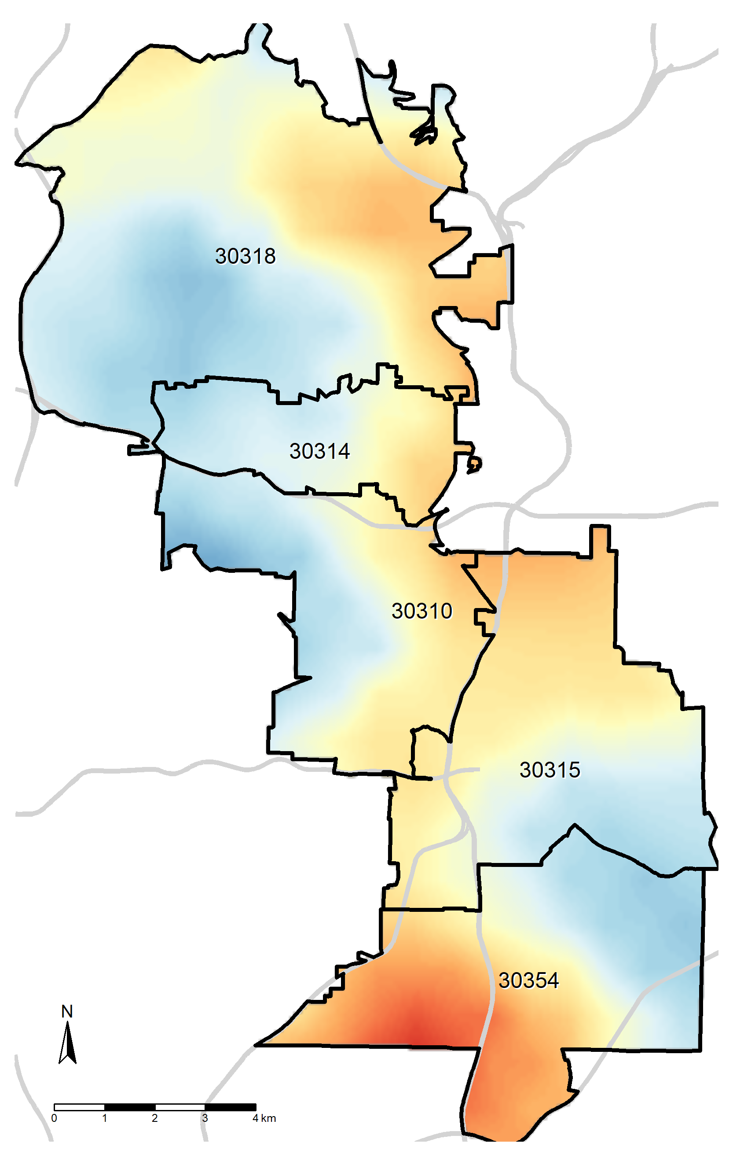
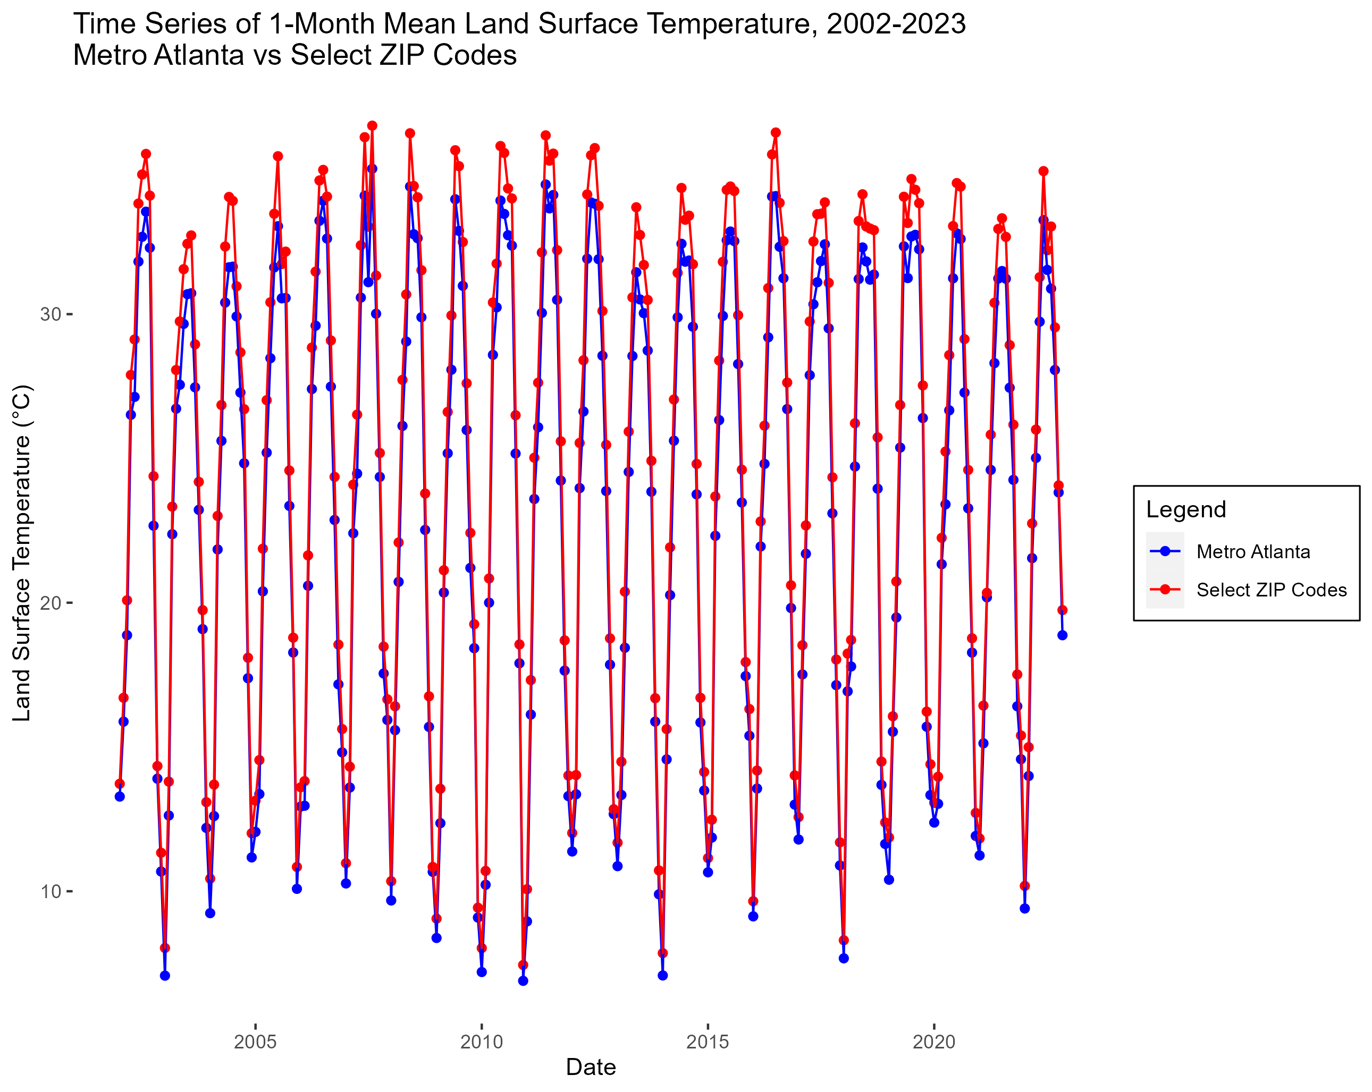
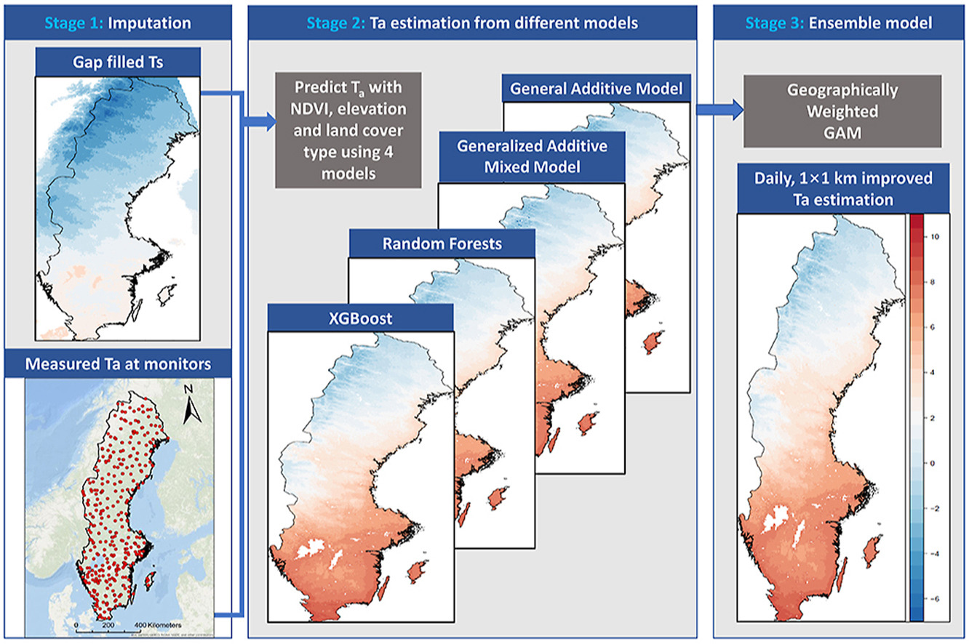
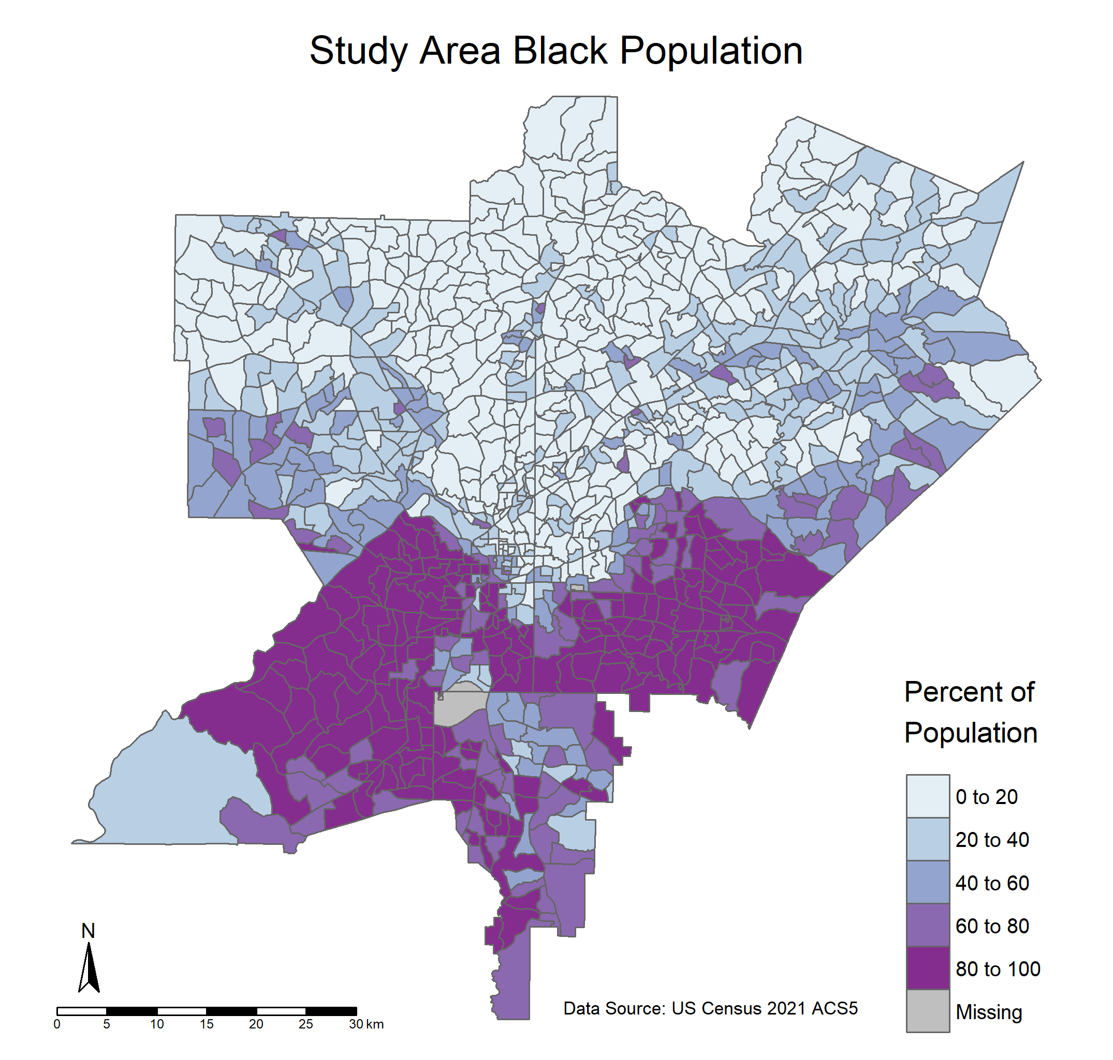
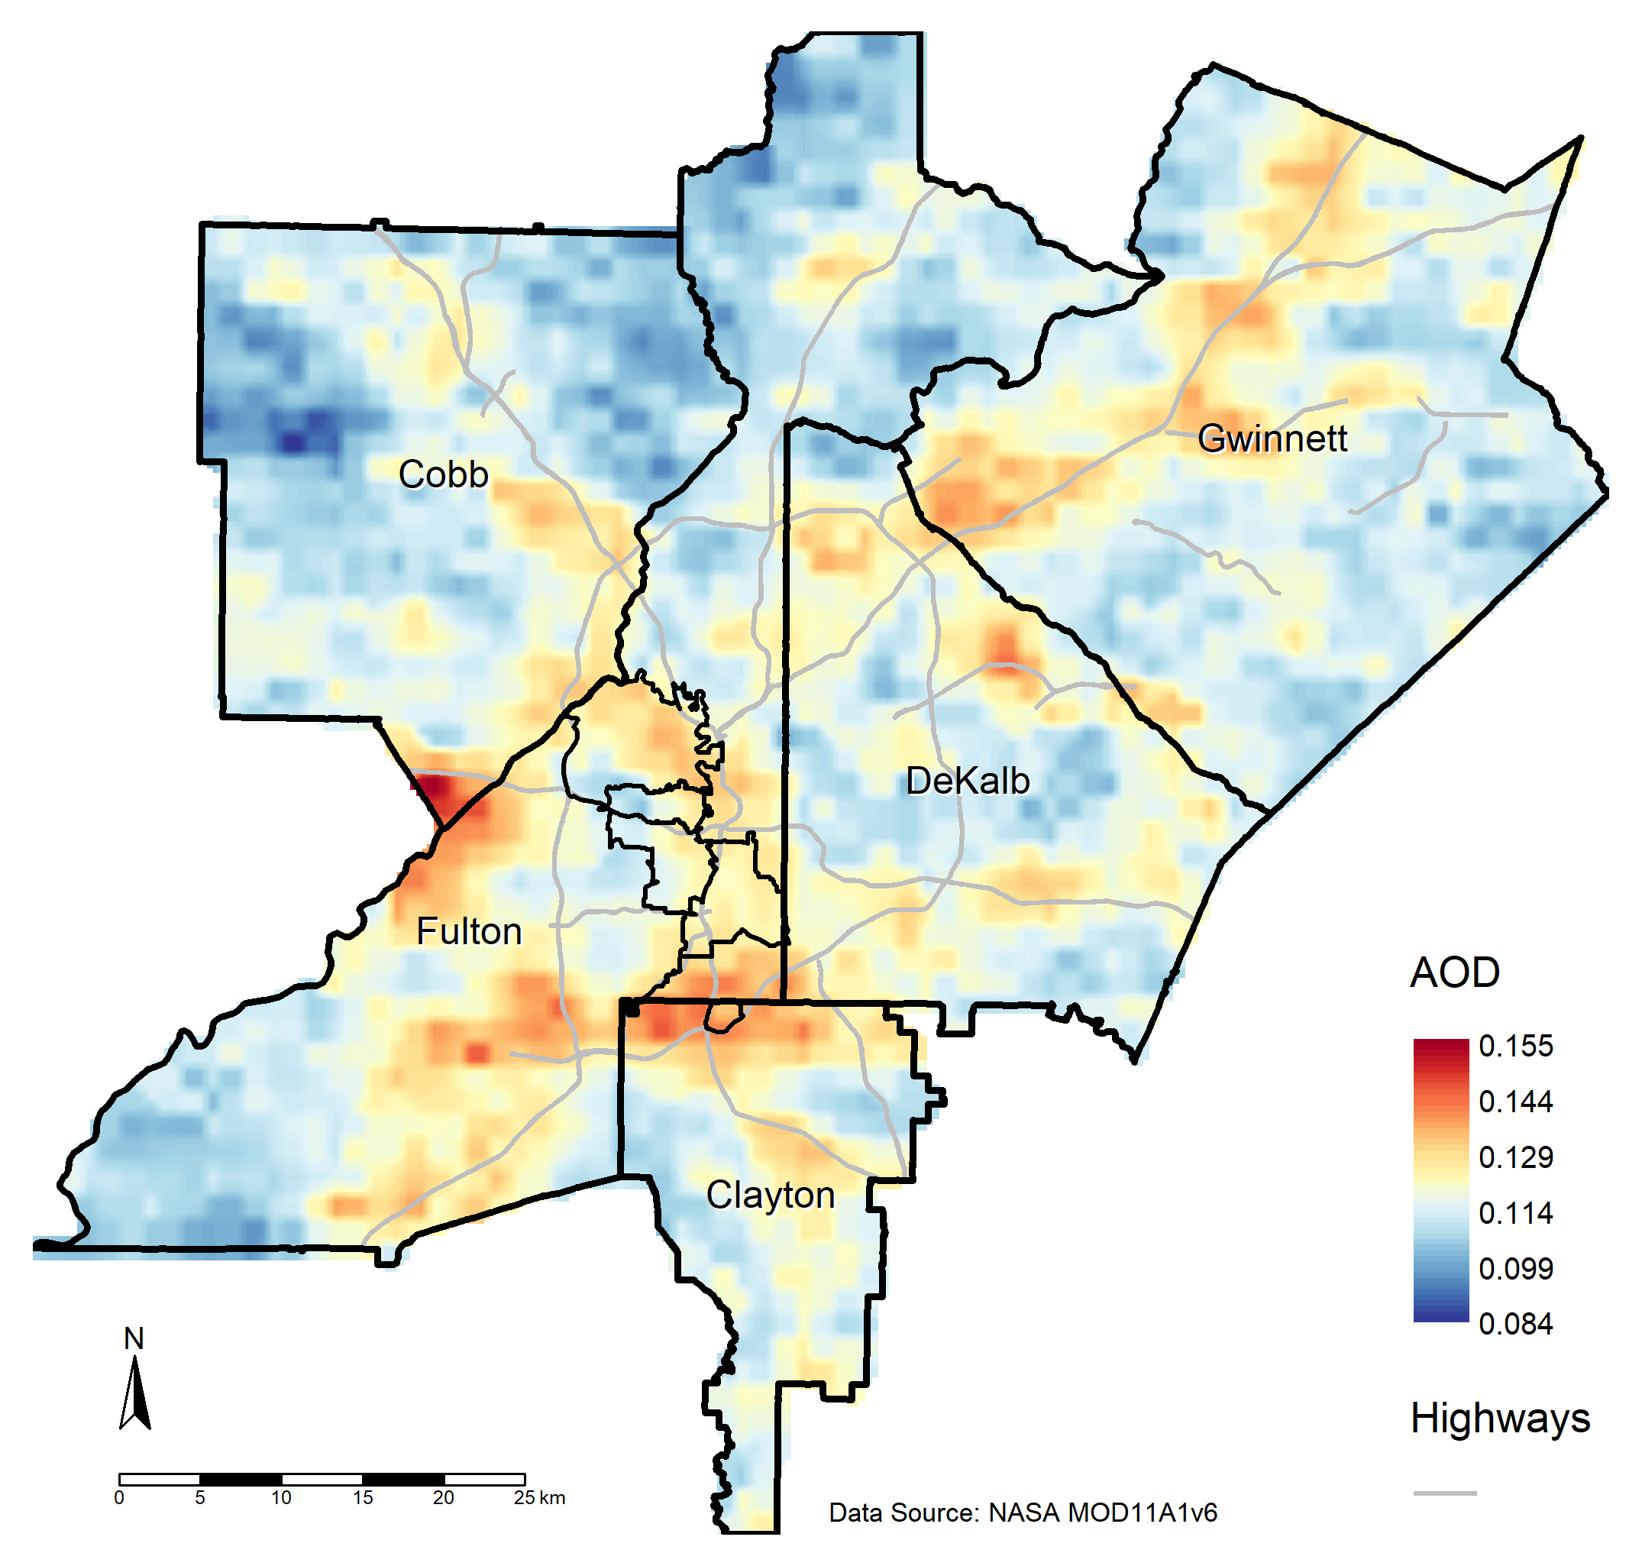
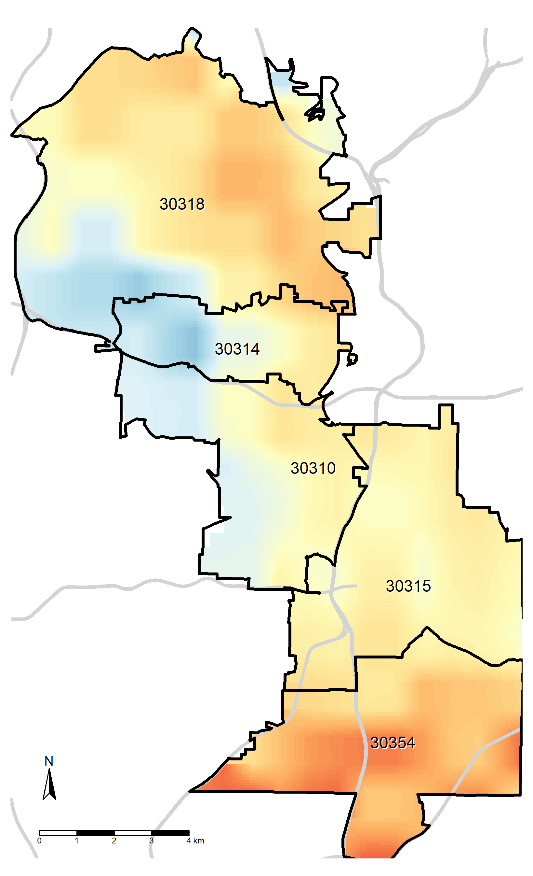
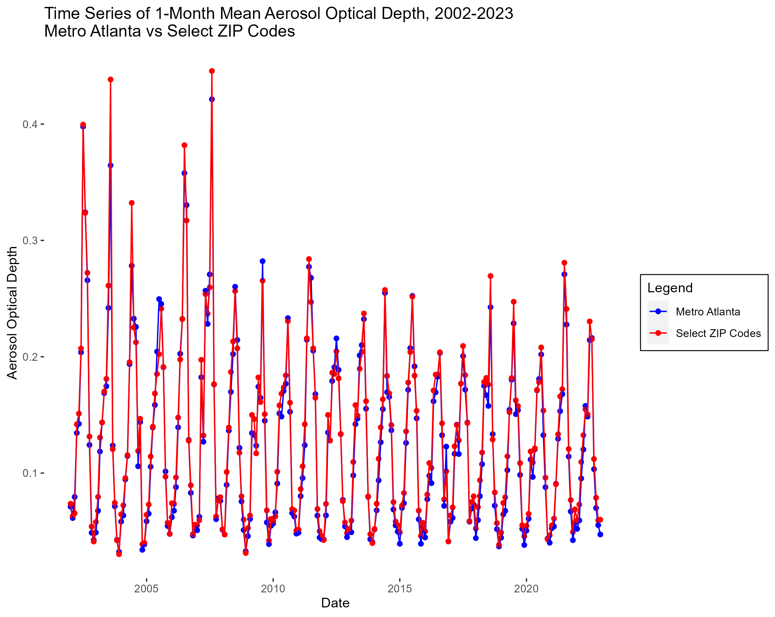
Using NASA Earth Observations to Support Environmental Justice Communities in Atlanta, Georgia Ethan Li¹, Yun Hang¹*, Melanie Pearson¹, Garry Harris², Christine Ekenga¹, Yang Liu¹, Erin Lebow-Skelley¹, Alina Merceron¹ ¹Rollins School of Public Health, Emory University, ²Center for Sustainable Communities, * Contact: yun.hang@emory.edu
Background
Climate change exacerbates environmental exposures, e.g. heat and air pollution.
Fig 1: Interactions of climate and air quality (Jacob, Winner 2009)
More severe health impacts among vulnerable populations
Fig 2. Socioeconomic factors and heat vulnerability (Gronlund 2014)
Methods
Satellite observations by NASA Moderate Resolution Imaging Spectroradiometer (MODIS)
NDVI from MODIS MOD13A1 16-day NDVI Product
Land Surface Temperature from MODIS MOD11A1 Daily LST Product
Aerosol Optical Depth from MODIS MAIAC MCD19A1 Daily AOD Product
Data analyzed in R
Results
Figure 7: Community engagement workshop held in April 2023
Community partners found initial analysis informative and useful
Requested incorporation of additional data, e.g. land use, and expansion of study area
Results
Figure 4: Distribution and 16-day average time series of NDVI in Study Area and Selected Zip Codes
Areas of low NDVI concentrated in Atlanta urban center and along major highways
Lower 16-day average NDVI values in ZIP codes of interest compared to general study area
Figure 5: Distribution and monthly average time series of land surface temperature (LST) in Study Area and Selected ZIP Codes
Areas of high land surface temperature found in urban center and along major highways, spatially correlated with areas of low NDVI
Higher average monthly land surface temperature in ZIP codes of interest compared to general study area
Figure 6: Distribution and monthly average time series of Aerosol Optical Depth (AOD) in Study Area and Selected ZIP Codes
Areas of high aerosol optical depth found over urban centers and major highways, but AOD is more evenly distributed compared to NDVI and LST
Average monthly AOD is higher in ZIP codes of interest vs general study area in summer months; however, differences are less clear/not present in rest of the year
Study Area 2022 NDVI
Select ZIP Codes 2022 NDVI
Conclusions and Future Work
Satellite observations can assess major environmental risk factors
Differences exist in exposure levels between EJ communities and other areas
Community input is important to direct research and interpret results
Integrate advanced modeling and land use data to further evaluate health impacts
Further community engagement needed to ensure future work meets community needs
Fig 8: Machine Learning for modeling air temperature (Jin et. al. 2022)
Study Area 2022 LST
Select ZIP Codes 2022 LST
Objectives
Use NASA Earth Observation satellite data to assess community environmental exposures in Atlanta
Enhance community understanding of environmental exposures and NASA Earth Observation data
Fig 3. Study Area with Distribution of Black Population
Study Area 2022 AOD
Select ZIP Codes 2022 AOD
Citations
Gronlund, C. J. (2014). Racial and socioeconomic disparities in heat-related health effects and their mechanisms: A review. Current Epidemiology Reports, 1(3), 165-173. https://doi.org/10.1007/s40471-014-0014-4
Jacob, D. J., & Winner, D.A. (2009). Effect of climate change on air quality. Atmospheric Environment, 43(1), 51-63. https://doi.org/10.1016/j.atmosenv.2008.09.051
Jin, Z., Ma, Y., Chu, L., Liu, Y., Dubrow, R., & Chen, K. (2022). Predicting spatiotemporally-resolved mean air temperature over Sweden from satellite data using an ensemble model. Environmental Research, 204, 111960. https://doi.org/10.1016/j.envres.2021.111960
Acknowledgements
This work was supported by the National Aeronautics and Space Administration (Grant 80NSSC22K1659). This content is solely the responsibility of the authors and does not necessarily represent the official views of NASA.
Notes:
Figure 4: Distribution of A) Green space, B) Air Pollution, C) Land Surface Temperature,
Figure 5: A) 2002-2023 Monthly Average LST, B) 2002-2023 16-Day Average NDVI

